Slide 1
Array 1st part
Rakib Mahmud

Slide 2
Scalar Variables versus Aggregate Variables
So far, the only variables we’ve seen are scalar: capable of holding a single data item.
C also supports aggregate variables, which can store collections of values.
There are two kinds of aggregates in C: arrays and structures.

Slide 3
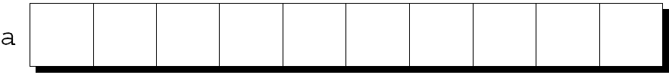
Introduction
Int roll1, roll2, roll3,…..,roll45 => int roll[45]
An array is a data structure containing a number of data values, all of which have the same type.
The simplest kind of array has just one dimension.
The elements of a one-dimensional array a are conceptually arranged one after another in a single row (or column):

Slide 4
Defining Arrays
When defining arrays, specify
Name
Type of array (Array can be defined over any type)
Number of elements which is array size.
arrayType arrayName[ numberOfElements ];
Examples:
float grade[ 7 ];
int c[ 10 ];
Defining multiple arrays of same type
Example:
int b[ 100 ], x[ 27 ];

Slide 5
Array Initialization
int roll[5];
It means roll[0], roll[1], roll[2], roll[3], roll[4]
0, 1, 2, 3, 4 these are indexes
roll[0] = 8
roll[1] = 9
roll[2] =7
roll[3] =10
roll [4] =6
Initialization array during declaration:
int roll[5] = {8, 9, 7, 10, 6}
int roll[ ] = {8, 9, 7, 10, 6}
roll[0] | roll[1] | roll[2] | roll[3] | roll[4]
8 | 9 | 7 | 10 | 6

Slide 6
Why array index starts from zero
int ara1[ ] = { 1, 2, 3, 4, 5};
Elements in the array are stored in consecutive memory locations.
ara1 represent base address (1000)
If we want to find address of another element = Base Address + Position * Data type size;
index | Address | Values
0 | 1000 | 1
1 | 1004 | 2
2 | 1008 | 3
3 | 1012 | 4
4 | 1016 | 5

Slide 7
Printing an array
int roll[5] = {8, 9, 7, 10, 6}
We want to show this output: 8, 9,10, 7, 6
printf(“%d\n”,roll[0]);
printf(“%d\n”,roll[1]);
printf(“%d\n”,roll[2]);
printf(“%d\n”,roll[3]);
printf(“%d\n”,roll[4]);
These values, known as elements, can be individually selected by their position within the array.
roll[0] | roll[1] | roll[2] | roll[3] | roll[4]
8 | 9 | 7 | 10 | 6
for(int i=0;i<=4;i++)
{
printf(“%d\n”,roll[i]);
}

Slide 8
Getting user input
int roll[5] = {8, 9, 7, 10, 6}
scanf(“%d”,&roll[0]);
scanf(“%d”,&roll[1]);
scanf(“%d”,&roll[2]);
scanf(“%d”,&roll[3]);
scanf(“%d”,&roll[4]);
roll[0] | roll[1] | roll[2] | roll[3] | roll[4]
roll[0] | roll[1] | roll[2] | roll[3] | roll[4]
8 | 9 | 7 | 10 | 6
for(int i=0;i<=4;i++)
{
scanf(“%d”,&roll[i]);
}

Slide 9
Types of Array
Array can of following types:
One dimensional (1-D) arrays or Linear arrays.
Example:
int roll[5];
Multi dimensional arrays
Two dimensional (2-D) arrays or Matrix arrays. Example:
int roll[2][3];
Three dimensional arrays. Example:
int marks[2][3][2];

Slide 10
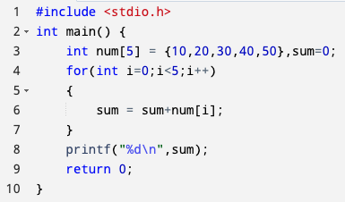
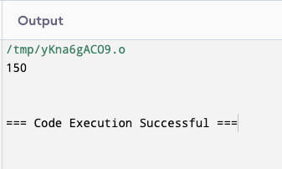
C Program to Find Sum of 1D Array (when array size is known)

Slide 11
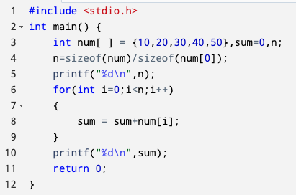
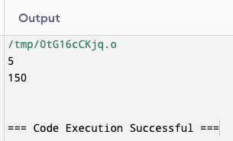
C Program to Find Sum of 1D Array (when array size is unknown)

Slide 12
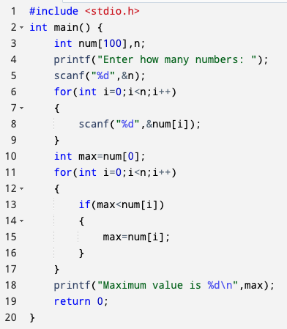
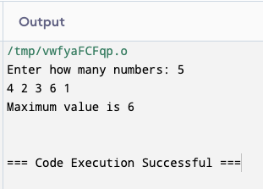
C Program to Find Maximum of an Array

Slide 13
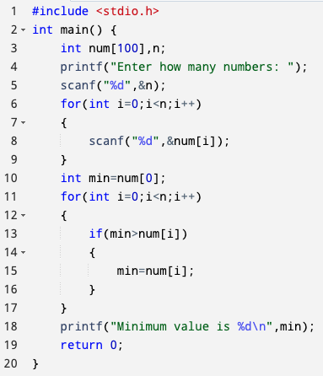
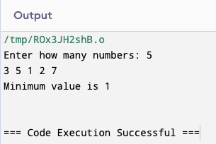
C Program to Find Minimum of an Array

Slide 14
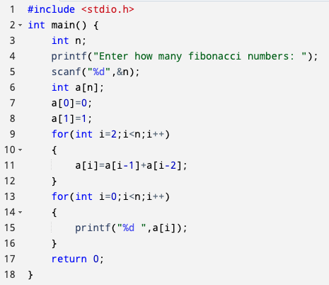
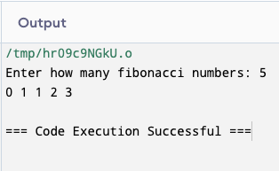
C Program to Make Fibonacci Series Using Array

Slide 15
Searching a number in array
The searching algorithm searches for the specified element in the given list.
Binary search and Linear search are the commonly used searching algorithm.
The linear search is the algorithm of choice for short lists, because it’s simple and requires minimal code to implement.

Slide 16
Linear Search
int num[ ] = { 1, 2, 7, 5, 4, 9 }
Search the value 5
If the item found?
If yes then what’s the position?
Ans: Yes, 4th position.

Slide 17
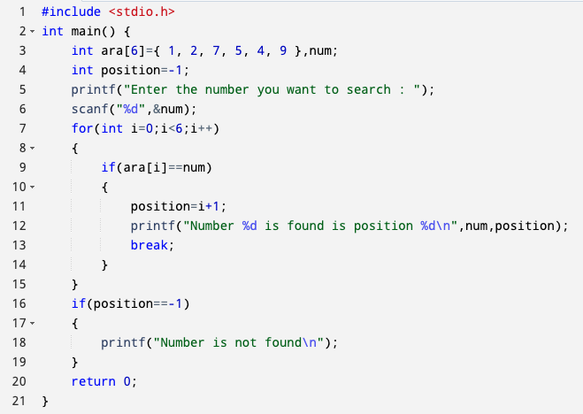
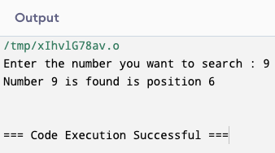
C Program to Perform Linear Search

Slide 18
Copy All the Elements of One Array to Another Array
Input:
First Array: ara1[5] = {3, 6, 9, 2, 5}
Output:
First Array : ara1[5] = {3, 6, 9, 2, 5}
Second Array : ara2[5] = {3, 6, 9, 2, 5}

Slide 19
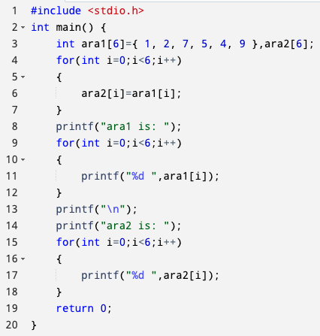
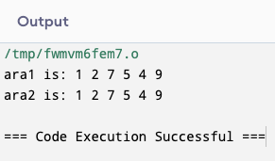
C Program to Copy All the Elements of One Array to Another Array

Slide 20
Thank You

